Slide 1
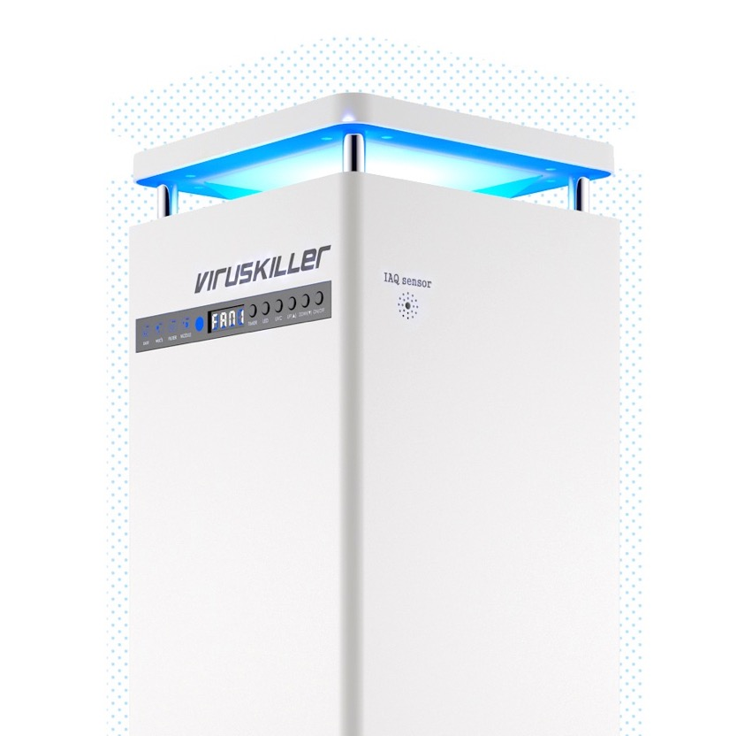
​
EDUCATION
info@clean-air.ie

Slide 2
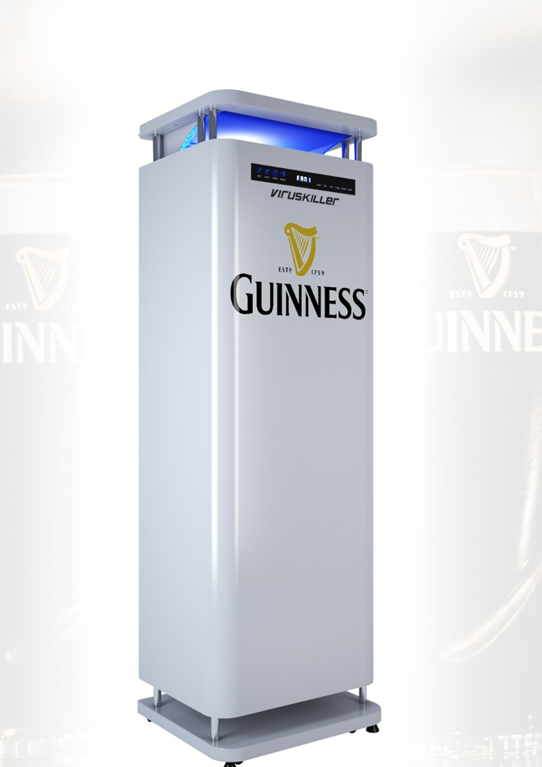
^{Summary}
The Risk
The Solution
Our Product Range & Technology
Installation & Maintenance
Contact Details

Slide 3
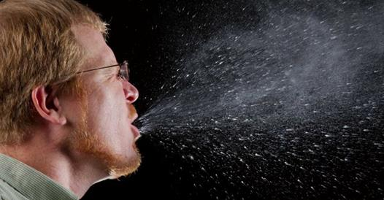
^{THE RISK}
COVID-19 has changed the general public’s perception on airborne contaminants, which will heavily impact the hospitality industry.
Virus containing aerosols can linger in the air for hours and pose a serious threat to customers and staff.
MUST STAY PROTECTED

Slide 4
^{THE RISK}
The COVID-19 pandemic represents an unprecedented global public. health crisis The hospitality sector is particularly at risk, due to cross contamination in places with high human concentration such as pubs.
The latest research shows that the transmission of Covid 19 is also spread in aerosols that can travel several meters and remain airborne for many hours.
Customers need to feel safe and relaxed when visiting a pub or restaurant.
Washing hands and surfaces, masks, social distancing and The use of natural ventilation and outdoor space can be very effective in clearing contaminated air but is a less palatable option as winter approaches.
Publicans and restauranteurs need to regain customers’ trust by implementing new technology for preventing cross contamination and keep customers and staff as safe as possible.

Slide 5
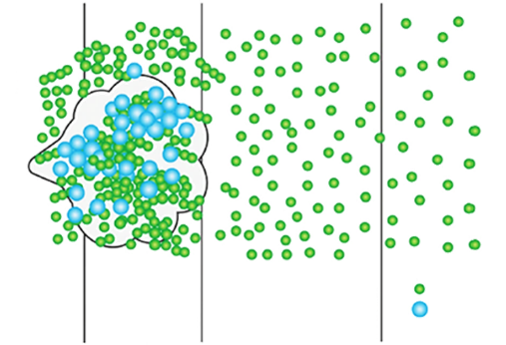
^{THE RISK}
[1]
A single sneeze can release 40,000 virus-containing droplets
Larger particles (5 to 15 micrometers [µm]) will not immediately drop to the ground but will remain airborne for several minutes.
Recent research studies^{[2]} confirm that COVID-19 can stay in the air for up to 3 HOURS!
As soon as cough/sneeze droplets hit the air,
they dry out and become light enough to leave suspended particles in the air
Particles from an infected individual can remain airborne for several hours.
Uninfected people who enter the room
are now at
Smaller particles (less than 5 µm) will remain in the air for many minutes or even hours.
(WHO)
50 cm
1m
Where large particles travel
4m+
Where small droplets actually travel
Small Droplets
RISK OF INFECTION
Large Droplets
[1] *Tang JW et al.: “Factors involved in the aerosol transmission of infection and control of ventilation in healthcare premises”. Journal of Hospital Infection, 2006
[2] Van Doremalen, N. et al.: “Aerosol and surface stability of HCoV-19 (SARS-CoV-2) compared to SARS-CoV-1”. Various research institutes, USA. 2020
[3] Bourouiba.L et al. : “Violent expiatory events: on coughing and sneezing”. Massachusetts Institute of Technology (MIT). Journal of Fluid Mechanics. Vol 745, Cambridge University Press. 2014
Small droplets can travel up to 8 meters at speeds of up to 320 km/h and be carried around by the air conditioning system^{[3]}

Slide 6
^{THE SOLUTION}
INFECTION PREVENTION & CONTROL
There are 4 disease transmission routes
?
Washing hands
Masks
Cleaning
surfaces
Sterilising
the air
Current infection prevention protocols do not properly address one of the most important disease transmission routes: AIRBORNE
Direct contact
Indirect contact
Air purification and sterilisation devices are needed.
To tackle droplet and airborne disease transmission routes
(and reduce direct and indirect contact transmission routes)
Droplets
Airborne

Slide 7
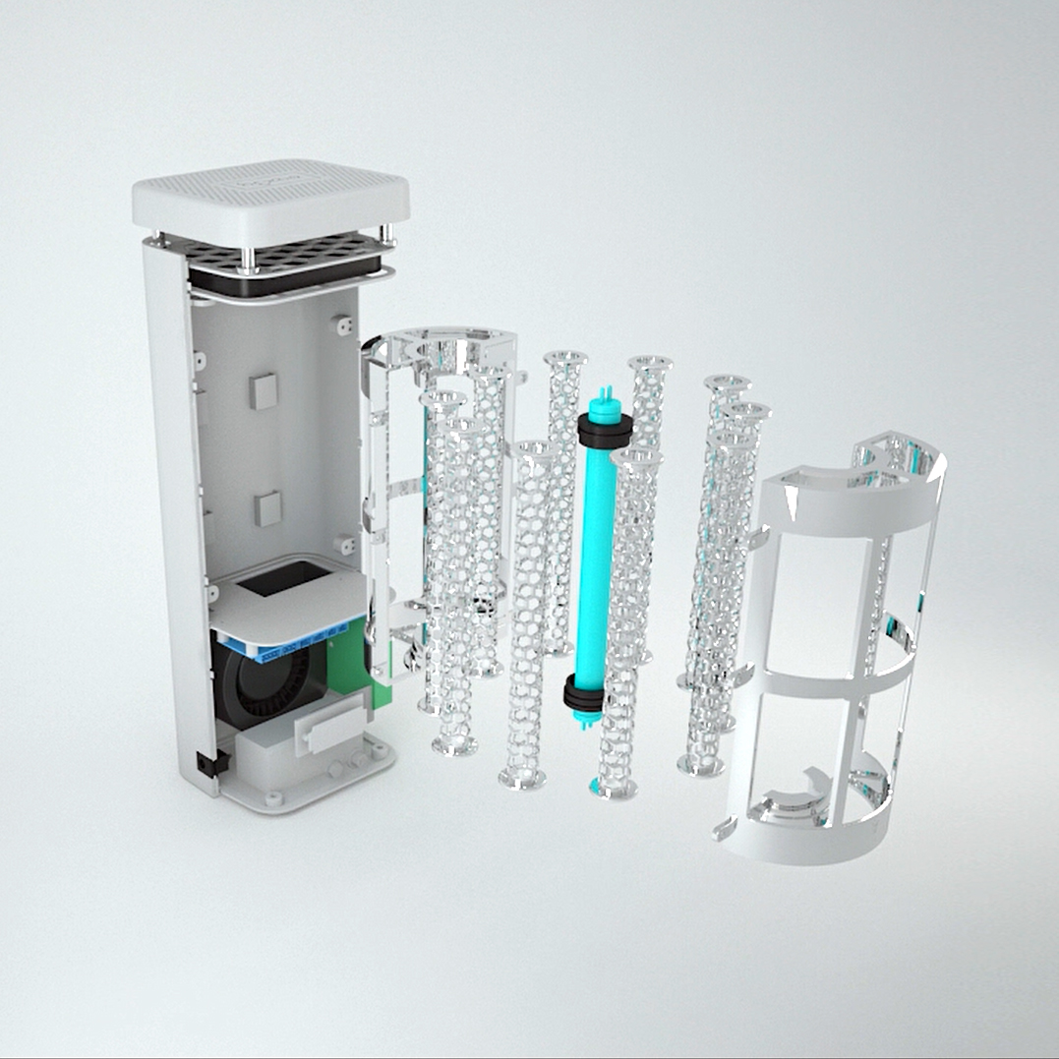
^{THE SOLUTION}
Install the highest certified clean air technology, which kills 99.9999% of all respiratory viruses in a single air pass.
CUSTOMERS CAN RELAX KNOWING THAT THEY ARE IN A SAFE ENVIRONMENT

Slide 8
THINGS TO CONSIDER WHEN REVIEWING ^{AIR CLEANING TECHNOLOGY}
How extensively has it been tested?
It’s important to know what pathogens the technology has been tested against. And, most importantly:
Has it been tested against viruses?
Another aspect to consider, is if the testing laboratory is independent to the company and authorised/official.
Does it achieve a single air pass kill rate?
Some companies will advertise 99.9999% efficiency, without advertising the testing methods.
If they don’t have single pass kill rates, their units may help to distribute viruses into the air, increasing cross contamination.
Can it properly control
the airflow?
Our technology aims to take contaminated air out of the breathing zone as quickly as possible and get it through the unit where viruses get killed.
Then, it pushes sterilized air back into the breathing zone, where it matters most.
It manages a room air exchanges very quickly
How much has it been implemented?
For the past 16 years, our technology has been focused on killing airborne viruses and has since been installed in over 80% of hospitals in South Korea, all lung examination rooms, most universities, and more.

Slide 9
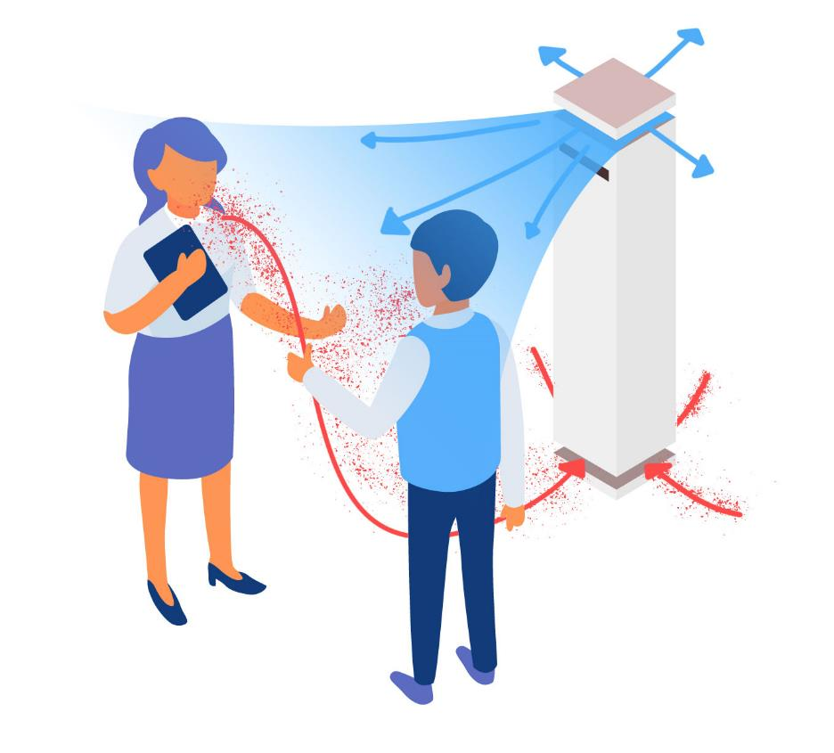
^{WHAT IS AIRFLOW CONTROL?}
If airflow is not controlled, droplets and aerosols can linger in the air for hours, even after people have left a room.
A Viruskiller™ unit constantly draws contaminated air down and away from the breathing zone, sterilizes it in a single air pass and releases virus-free air back into the breathing zone, pushing contaminated air and repeating the cycle.
The breathing zone, which is the most important, is continuously filled with sterilized air, while contaminated air is pulled down and away.
This is proper airflow control.

Slide 10
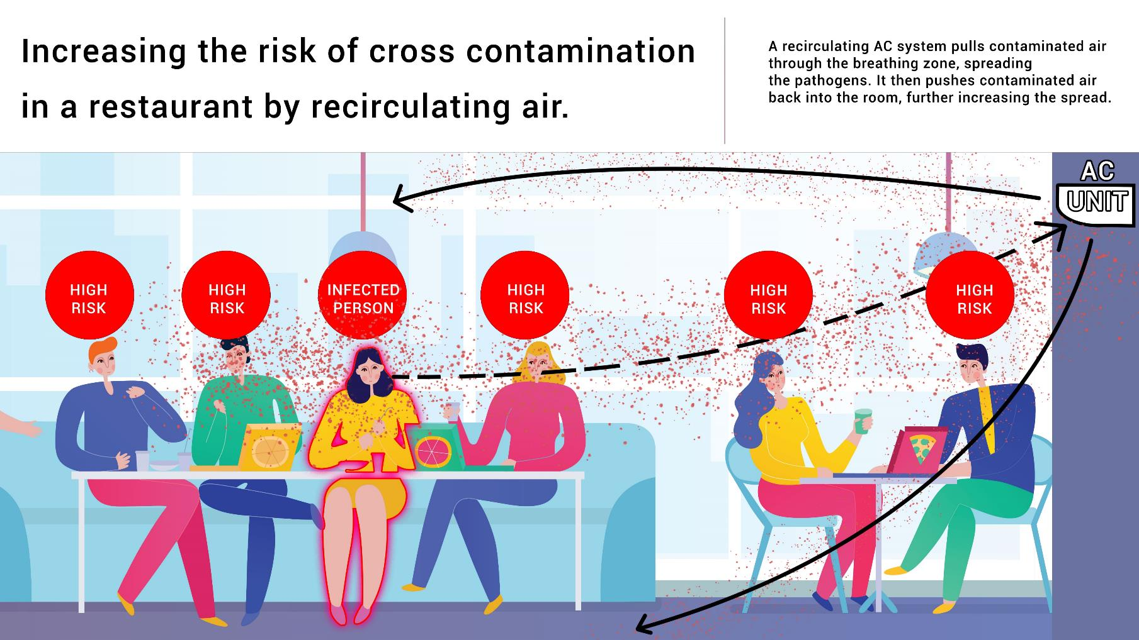

Slide 11
^{HOW VIRUSKILLER™ WORKS}
Safe, virus-free air is released from the top
Particles that are too small to be effectively caught by filters, such as viruses, are killed in our patented reactor chamber in a single air pass.
Contaminated air is drawn away from the breathing zone and down into the unit.
Larger, coarse particles are caught in the Pre Filter, HEPA filter and Carbon Filter.

Slide 12
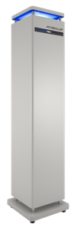
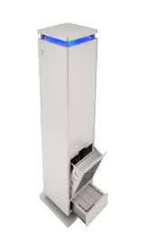
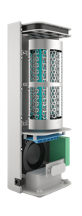
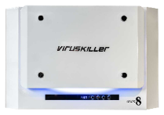
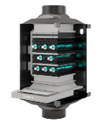
^{OUR CORE PRODUCT RANGE}
VK 103
VK 401
Hextio
IAQ Inline
Coverage (m2)
100
60
20
100
Dimensions (mm)
1570 x 320 x 320
365 x 166 x 581
124 x 330 x 104
315 x 300 x 450
Weight
42kg
12.9 kg
1,2 kg
12 kg
Description
Perfectly suited to open plan spaces large areas such reception areas, pubs, gyms and restaurants
With its large air exchange capacity, VK401 is ideal for offices, smaller pubs, bars and
restaurants, hallways and larger bedrooms
Ideal for personal use in a small office, bedrooms or reception desks. The unit is portable and can be placed anywhere.
The IAQ Inline
complements
existing ventilation systems and can be installed wall-hung or ceiling mounted.

Slide 13
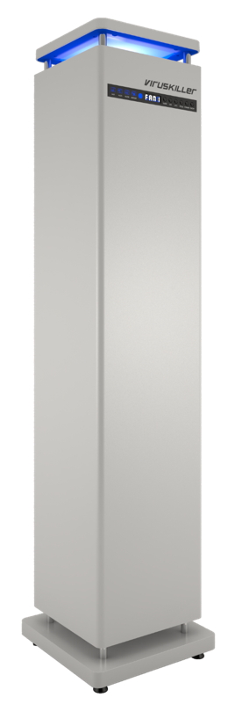
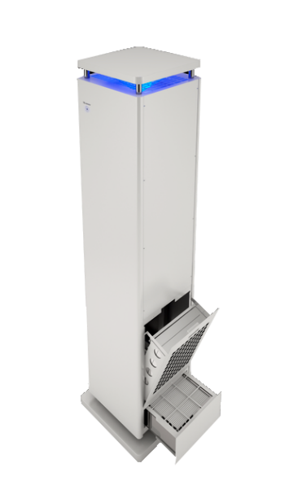
^{VIRUSKILLER VK 103}
* With a maximum ceiling height of 2.4m
Powerful unit for large areas up to 100m² *
Low running costs
Simple installation and maintenance
Free standing
Specs
X 8 UVC lamps
≃ 70 chromed TiO₂ hexagon filters
Noise 40-49 dB
Airflow 200-358 CFM
Max Electricity 210 W
Double filtration: 2 filtration trays (back and floor)
Dimensions: 1570 x 320 x 320 mm
Weight: 42 kg
VK103 can duct in and filter external air which creates positive air pressure in the room.
Notes:
VK 102

Slide 14
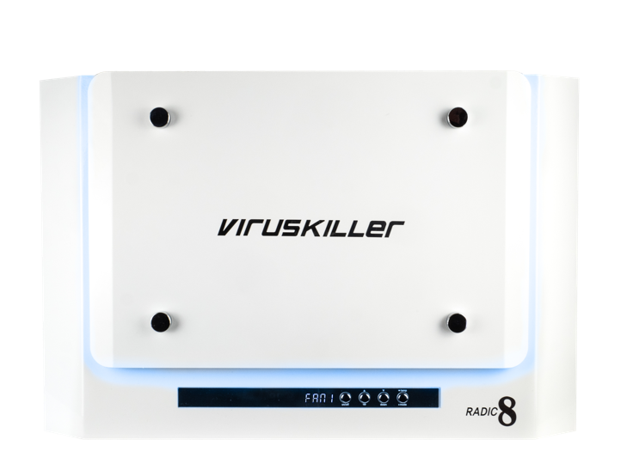
^{VIRUSKILLER VK 401}
* With a maximum ceiling height of 2.4m
Powerful unit for medium areas up to 60m² *
Low running costs
Simple installation and maintenance
Wall-hung or Free standing
Compact, powerful and stylish
Specs
X 8 UVC lamps
≃ 40 chromed TiO₂ hexagon filters
Noise 38-44 dB
Airflow 70-141 CFM
Max Electricity 96 W
Dimensions: 365 x 166 x 581 mm
Weight: 12.9 kg
Choice of white with blue LED or black with amber LED
Notes:
VK 401

Slide 15
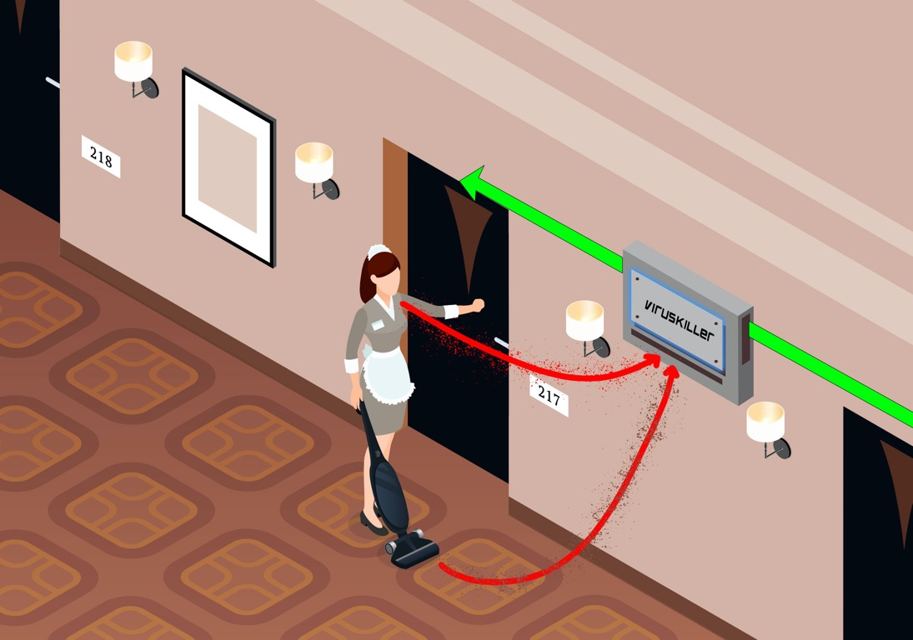
Radic8 technology can play a key role
VK 401
The VK 401 creates an airflow which draws contaminated air away from the breathing zone and towards the Viruskiller
Air is cleaned and viruses are killed
Sterilised air is flowed back to the guests’ and staff’s breathing space

Slide 16
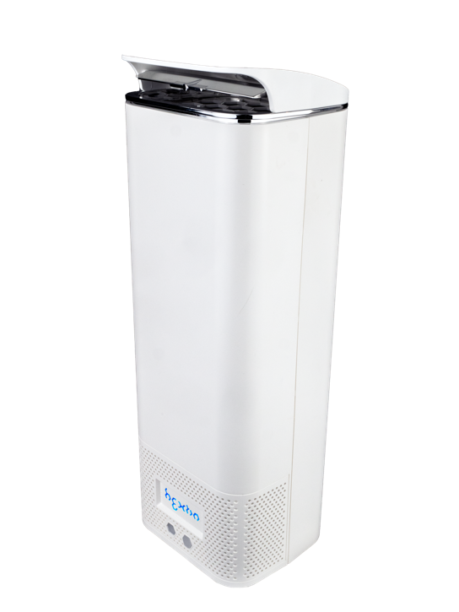
^{HEXTIO}
* With a maximum ceiling height of 2.4m
Powerful unit for small areas up to 20m² *
Low running costs
Simple installation and maintenance
Compact, powerful and portable
Wall-hung or free standing
Specs
X 1 UVC lamp
X 10 chromed TiO₂ hexagon filters
Noise 40-49 dB
Max Electricity 15 W
Dimensions: 124 x 330 x 104 mm
Weight: 1.2 kg
Notes:
Hextio – consumer product

Slide 17
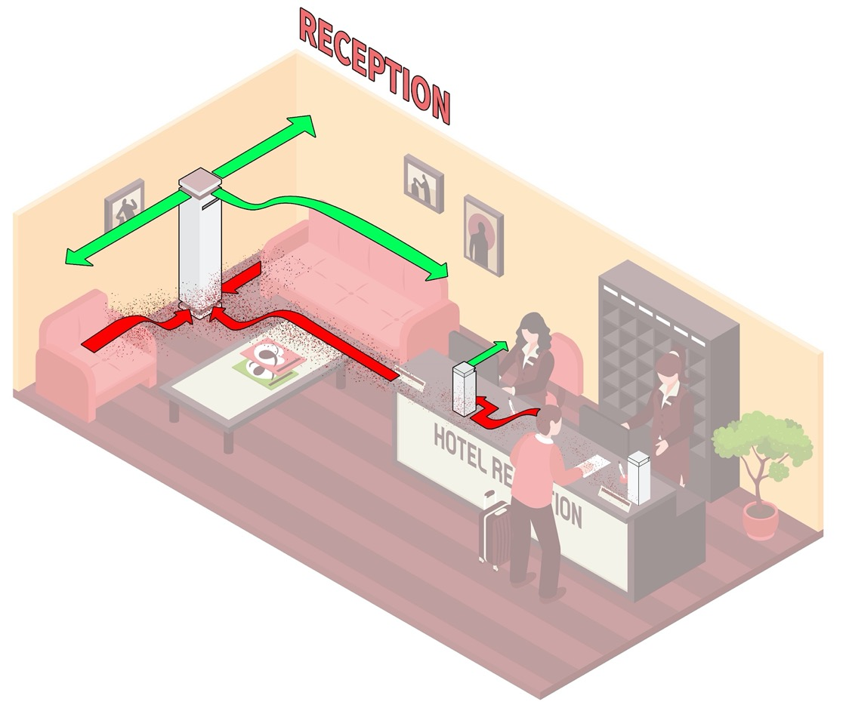
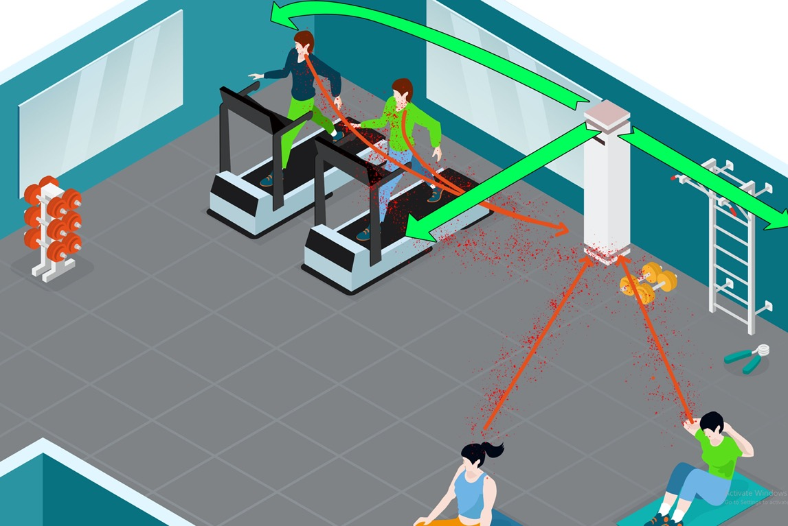
Radic8 technology can play a key role
VK 103
The VK 103 creates an airflow which draws contaminated air away from the breathing zone and towards the Viruskiller
Air is cleaned and viruses are killed
Sterilised air is flowed back to the guests’ and staff’s breathing space

Slide 18
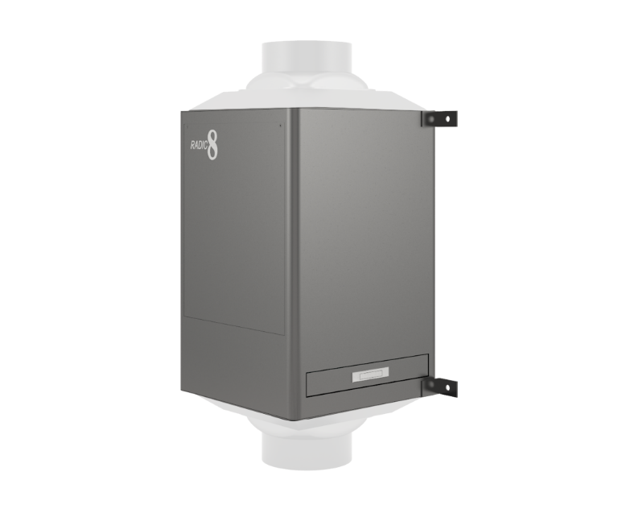
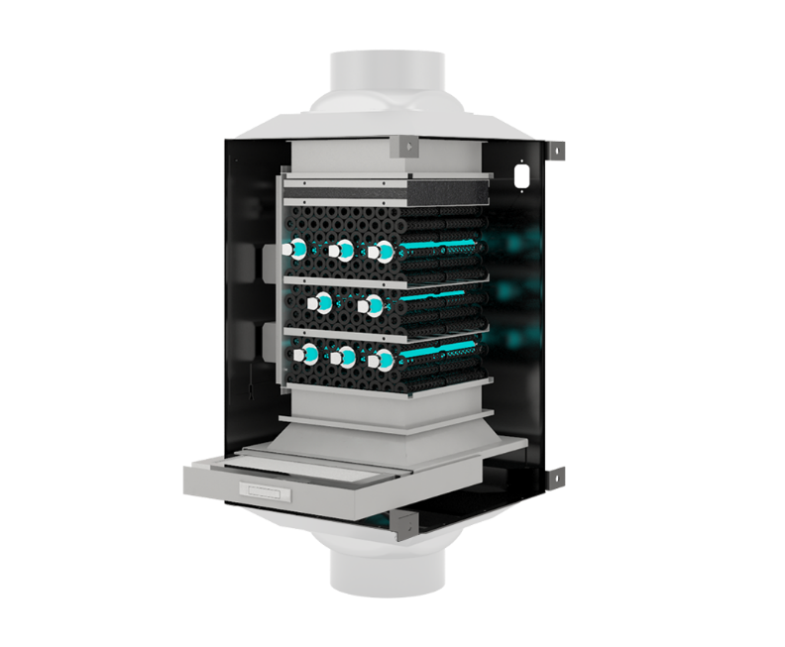
^{IAQ Inline}
Powerful unit for HVAC ducting
Low running costs
Simple installation and maintenance
Compact, powerful and portable
Wall-hung or free standing
Specs
X 8 UVC lamp
X 40 chromed TiO₂ hexagon filters with activated carbon
Recommended Airflow: up to 317 CFM
Filtration: Pre Filter, HEPA filter
Modular unit: multiple units can be stacked next to each other to cover more airflow. (4 units cover 4 x 317 CFM)
Notes:
Hextio – consumer product

Slide 19
^{LIFESPAN OF OUR UNITS}
Our units themselves have a 10-year life span and come with a 1-year warranty
VK 103
VK 401
HEXTIO
IAQ INLINE
Reactor Cell
8000h
Lower tray
Washable pre-filter (5mm)
HEPA filter (35mm)
6000h
2 Activated Carbon filters (20mm) 6000h
Back tray
Washable pre-filter (5mm)
HEPA filter (35mm)
6000h
2 Activated Carbon filters (20mm)
6000h
Reactor Cell
8000h
Front tray
Washable pre-filter (5mm)
HEPA filter (20mm)
2000h
2 Activated Carbon filters (15mm)
6000h
Back tray (n/a)
Reactor Cell
8000h
Upper tray
Washable pre-filter (n/a)
HEPA filter
4000h
Activated Carbon filter
4000h
Back tray (n/a)
Reactor Cell
8000h
Washable pre-filter (5mm)
HEPA filter (25mm)
6000h
Activated Carbon filter (20mm)
6000h
Back tray (n/a)
If running 8h/day (all week)
Hours | Months | Years
2000 | 8 | -
4000 | 16 | 1 year 4 months
6000 | 25 | 2 years 1 month
8000 | 33 | 2 years 9 months
If running 24h/day
Hours | Months
2000 | 3
4000 | 6
6000 | 8
8000 | 11
Notes:
Hextio – consumer product

Slide 20
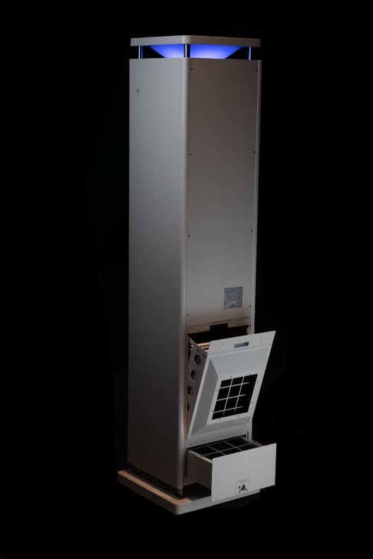
^{MAINTENANCE}
EASY REPLACEMENT OF PARTS
1. PRE-FILTER
Wipe or vacuum the pre-filter on a weekly basis. The pre-filter only captures the big particles. Hazardous particles won’t remain on it.
2. HEPA & CARBON FILTERS
These filters need to be changed every 6000 hours in a VK103, 2000 hours in a VK401 and every 6 months in a Hextio.
3. REACTOR CHAMBER
The reactor chamber can also be easily replaced without assistance of a technician.
Simply remove the filter trays and vacuum clean the pre filter. The pre filter is always at the bottom.
When changing filters, they must be handled with gloves and placed into a bag for disposal.
*All units are under a one year warranty
** Distributor will take care of the spare parts if they need replacement

Slide 21
^{Contact us}
www.ecocool.ie
David@ecocool.ie
0879879943

Slide 22
www.radic8.com

