Slide 1
The Inside Track On Intimate Weddings
A conversation with Wedding Planners
Tara Fay & Bruce Russell

Slide 2
Welcome & Introductions

Slide 3
Maximising Revenue
Min costs Vs Min numbers
Flexibility
F&B Spend
Menu Design
Use of Inhouse display
Re-imagine your presentations

Slide 4
Top Tips Layout – Décor - Menus
Take an interior design approach
Privatise public spaces
Use what you have at your disposal
Think outside the “Package”

Slide 5
Effective Communication
There are two things that can destroy any relationship – Unrealistic expectations and poor communications
Weddings have the capacity to destroy both
Good Communication has to be understood
What do I need to get across
What do they automatically think
What do I want them to think
What do I want them to do

Slide 6
Examples
My venue is saying that our wedding is going to be the last one they will do for 25 people as its not paying them, they are also saying now we have to pay an additional room hire amount on top of our menu cost and they are charging us for 40 people, can they do this?
Answer

Slide 7
Examples
My venue planner has left but she told us children under 6 did not count as part of the 25 guests, she also told us we could have a private room for dining and music. Now we are told the room needs to be vacated by 6pm unless we pay a venue rental fee what should we do?
Answer

Slide 8
Non Verbal Communication
The power of misinterpretation from email
Reframe the Problem
“What’s your problem?
Thomas Wedell – Wedellsborg
Social Media
Its all in the delivery
Use of Video

Slide 9
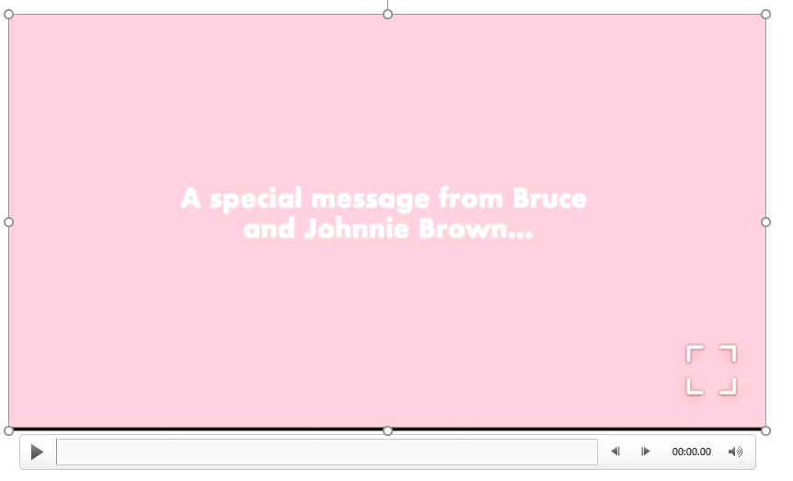

Slide 10
Selling Strategies Intimate Weddings
One size doesn’t fit all
The personal approach
It’s all about the spend
Communication & Understanding

Slide 11
Recap
Open effective and clear communication will always win out
Team buy-in
Empower and train your wedding professionals
Simplify your sales process
Look outside the box for revenue streams
Adapt and train now for the long term
Think beyond Covid

Slide 12
Thank You!
www.bruceandtaralive.com
@bruceandtaralive

