Slide 1
National Revaluation Programme: REVAL 2023 Irish Hotels Federation
5th October 2022
Declan Lavelle – Head of Valuation Services
Terry Fahey – Director of Revaluation

Slide 2
Areas Covered - Valuation Office & Rating System in Ireland - Reval 23 & National Revaluation Programme - Governing Legislation - Revaluation Process & Ratepayer Supports - Appeal Mechanisms - Key Dates - Q & A
Draft

Slide 3
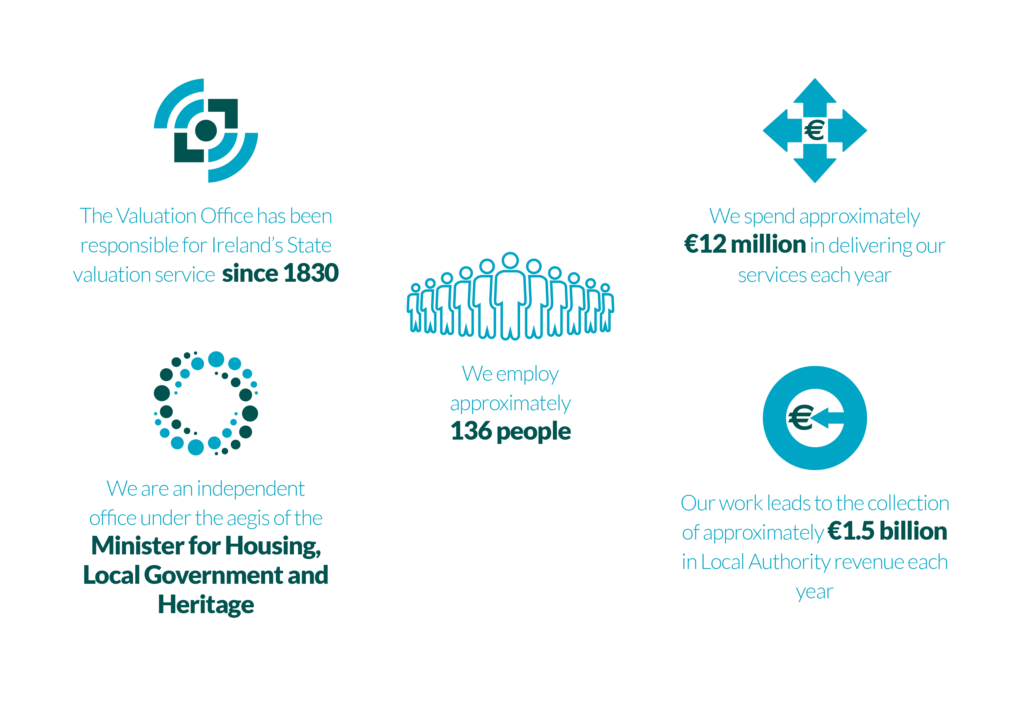
Valuation Office - Who we are & What we do
Draft

Slide 4
Rates and Rateable Valuation Three figures relevant to Commercial Rates: - Overall Rates contribution to Annual Budget: Decided by Elected Members of Local Authority - Rateable Valuation of Individual Properties (“Net Annual Value”): Determined by Valuation Office - Annual Rate on Valuation (ARV): Set by Elected Members Valuation x ARV = Amount of Rates liable for collection by Local Authority
Draft

Slide 5
What is Revaluation? - Revaluation is a Reassessment from first principles of the rateable value of all properties in a Local Authority area at the same time, by reference to the same valuation date - Leads to Redistribution of commercial rates burden between ratepayers - Revenue Neutral for Local Authorities - Recurring exercise (every 5 to 10 years) to maintain the fairness of rating system - Results in production of New Valuation List that contains modern valuations for all rateable properties in Local Authority area
Draft

Slide 6
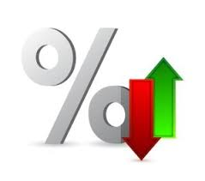
Revaluation - Why? Restore relativity between different properties, categories & locations: - Take account of movements in rental values across different sectors/locations which occur over time - Reflect Local Economic Factors Transparency: - Bring Rateable Values back into line with modern property rental values - Current market rental values - Result Fairness and Equity
Draft

Slide 7
Reval 2023
Draft
The revaluation of approximately 29,000 Industrial and Commercial properties in Clare, Donegal, Galway, Kerry and Mayo County Councils and Galway City Council rating authority areas and the revaluation of approx. 5,000 properties in Dún Laoghaire-Rathdown for the second time is being progressed.
Valuation Date – 1st February 2022
Proposed Valuation Certs Issue Date – 23rd September 2022
Final Certs & Publication of new Valuation List – 22nd September 2023
New Valuations become effective for Rates – 1st January 2024

Slide 8
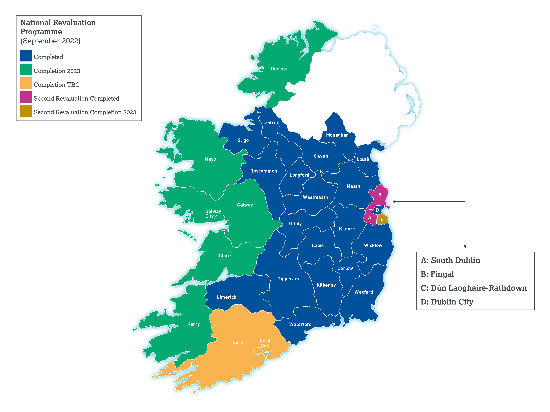
Draft
Advancing the National Revaluation Programme is a key priority for the period 2022-2024.

Slide 9
Revaluation: Legal Context - Part 5 of Valuation Acts 2001 to 2020: https://www.valoff.ie/en/about-us/legislation/ - “Net Annual Value” specifically defined in legislation Rental Value, not Capital Value “Correctness” and “Equity & Uniformity” - Decisions of independent Valuation Tribunal & Higher Courts
Draft

Slide 10
Revenue Neutral for Council - Revaluation is about Redistribution of rates liability - Rates liability of individual ratepayers may change - “Revenue neutral” for Local Authority: Ministerial Rates Cap: Sec. 56 Valuation Act 2001, as amended by Local Government Rates and Other Matters Act 2019 Subject to Sec 56, total amount of rates income remains the same Benefit from Inflation, New Developments, Improvements to existing buildings Benefit from Global Valuations in same year as new list is published Contingency for “Leakage” from new valuation list arising from appeals
Draft

Slide 11
Before & After examples
Draft
 | Property A | Property B | Property C
Old Rateable Valuation | €63.09 | €63.09 | €63.09
Kerry ARV 2022 | 79.25 | 79.25 | 79.25
Rates Liability before Revaluation (Rounded) | €5,000 | €5,000 | €5,000
Net Annual Value (NAV) after Revaluation | €20,000 | €22,000 | €18,000
Indicative ARV after Revaluation*** | 0.25 | 0.25 | 0.25
Rates Liability after Revaluation | €5,000 | €5,500 | €4,500
Change in Liability due to Revaluation | No Change | +€500 | -€500

Slide 12
Indicative ARV advised by Local Authorities - Indicative ARV calculated by reference to 2022 LA budget figure for rates - Aggregate value on Local Authority Valuation List - Range of Indicative Values Galway City - 0.217 Galway County - 0.21 Donegal - 0.232 Kerry - 0.227 Clare - 0.25 Mayo - 0.239 Dun Laoghaire Rathdown - 0.193
Draft

Slide 13
Key Steps in a Revaluation - VO issues Proposed Valuation Certificates - Rating Authority makes Indicative ARV available to Ratepayers - “Representations” made to Valuation Office (40 days) - VO considers Representations - VO issues final Valuation Certificates - Commissioner publishes new Valuation List for Rating Authority - Appeals can be made to Valuation Tribunal (within 28 days) - Elected Members of Rating Authority set ARV - New Valuation List becomes effective
Draft

Slide 14
Valuation Scheme Hotels Valuation Scheme: Room Sales: % of FMT Drink Sales: % of FMT Food Sales: % of FMT Conference: % of FMT Leisure: % of FMT Sundry: % of FMT % taken of each income stream varies
Draft

Slide 15
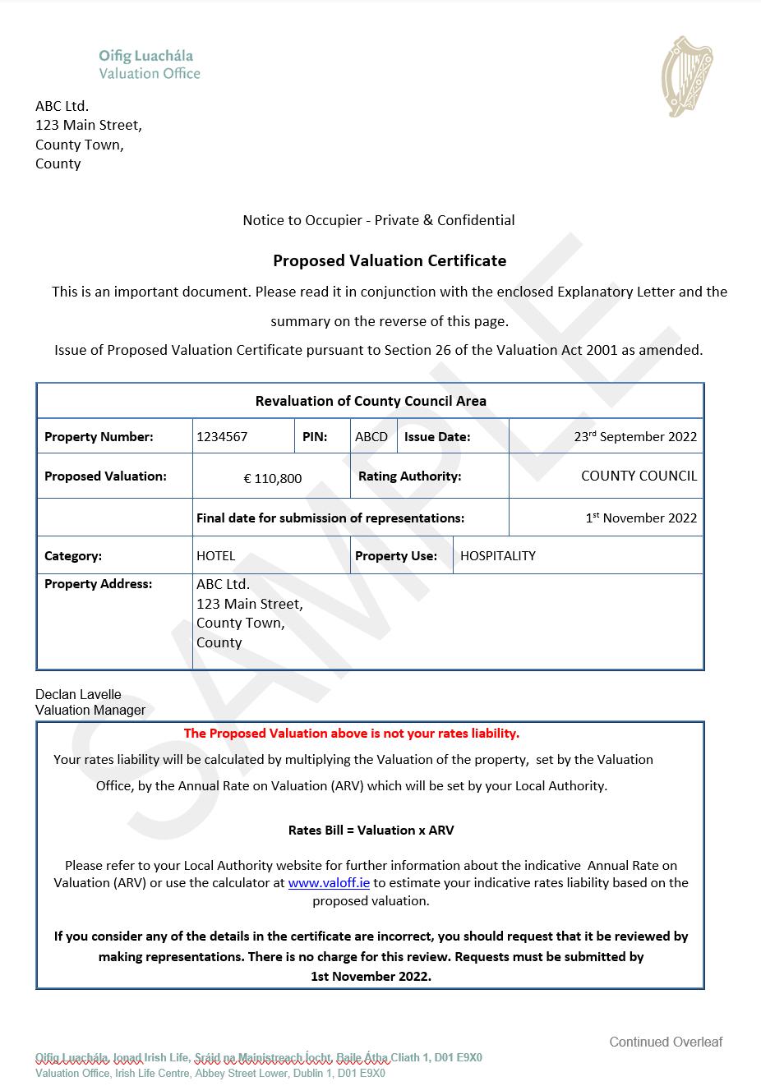
Sample Valuation Certificate
Draft

Slide 16
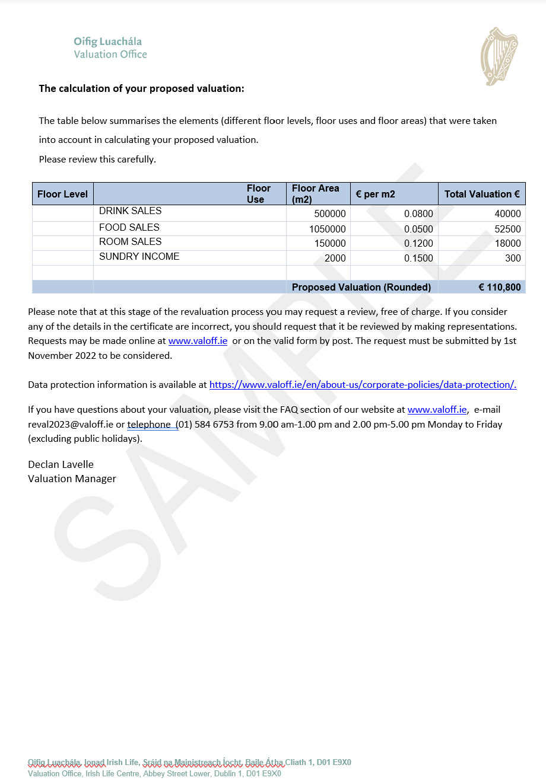
Sample Valuation Certificate
Draft

Slide 17
Is my Proposed Valuation Correct? Compare the Valuation (NAV) to - Rent you are paying - Rent you know others are paying for similar properties - Rents on PSRA Website - Actual Income Streams v Income Streams as assessed by VO - Rent you would receive/accept if vacant and to let. Have you provided your rental information?
Draft

Slide 18
Appeal Mechanisms - “Representations” to Valuation Office by Ratepayer 40 days from issue of Proposed Valuation certificate Informal process with no fee Happens before valuation is finalised - Valuation Tribunal 28 days Statutory Fee Formal and quasi-judicial process - Three possible outcomes: No change Valuation decreased Valuation increased - Appeal to Higher Courts on Point of Law
Draft

Slide 19
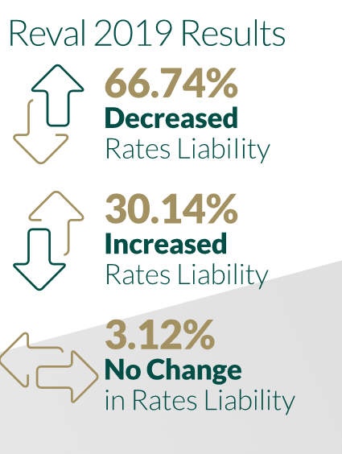
Reval 2019 - Outcomes
Draft
The last Revaluation Project in 2019 resulted in reduced rates for the majority of ratepayers

Slide 20
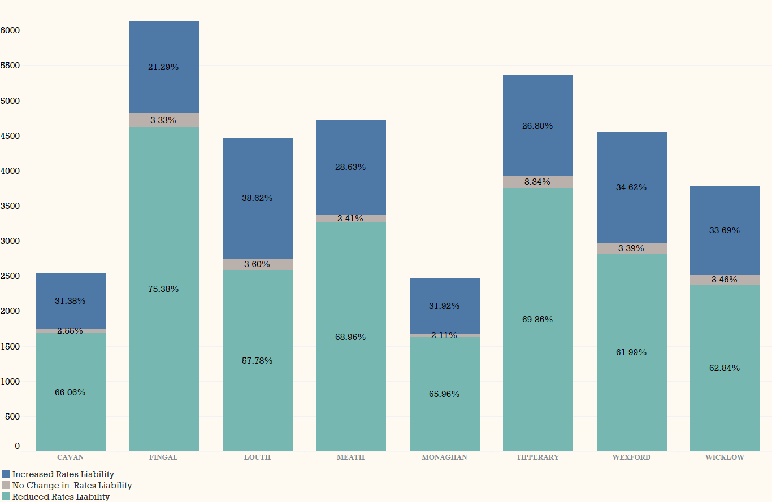
Revaluation Outcomes – Reval 2019
Draft

Slide 21
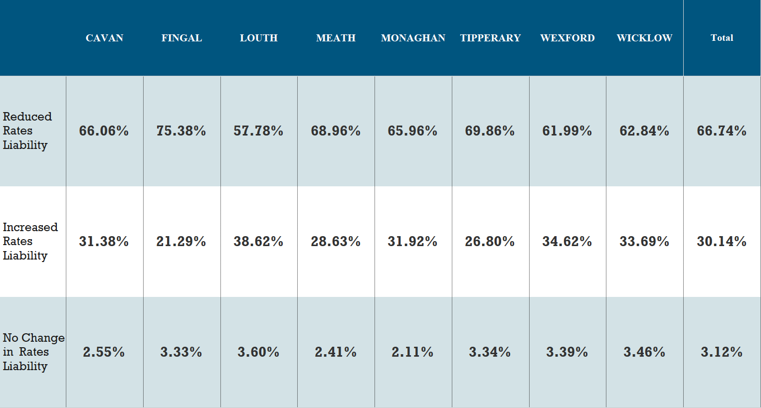
Revaluation Outcomes – Reval 2019
Draft

Slide 22
VO Supports for Ratepayers -VO provides hardcopy material to Ratepayers Making of the Valuation Order Issue of Proposed Valuation Certificates Issue of Final Valuation Certificates - Media advertisements - Briefing of Elected Representatives & copies of Specimen Documents - “Walk-in” Clinics for ratepayers - Extensive engagement with Trade Bodies & representative groups
Draft

Slide 23
Ratepayer Supports
Draft

Slide 24
Reval 2023 Support Team
Draft
E-mail: reval2023@valoff.ie Website: Up to date FAQ section and enquiry form
Ratepayer Dedicated Phone Line: 01 5846753 Local Authority Dedicated Phone Line: 01 817 1033 ( Not for Ratepayers)
Best Channels: E-mail and Web Enquiry Form via the website

Slide 25
Key Dates / Timelines - Proposed Valuation Certificates issuing will issue on Sept 23rd 2022 & 6th Jan 2023 - Period for making Representations: 40 days - Walk in Clinics in each Municipality: 3rd to 7th October 2022 - Publication of new Valuation List: 22nd September 2023 - Appeals to Valuation Tribunal – within 28 Days - New List effective for Rates purposes: 1st January 2024
Draft

Slide 26
Summary - “Revenue Neutral” for Local Authority - Based entirely on Local Evidence - Dissatisfied with proposed valuation? - Ratepayer makes representations to VO online - VO’s Objective - Publish a Valuation List that is Fair & Equitable for every Ratepayer and to Local Authority - Well established statutory process - Appeal to independent Valuation Tribunal
Draft

